Slide 1
Chapter 10:
Trees
Data Structures in Java: From Abstract Data Types to the Java Collections Framework
by Simon Gray

Slide 2
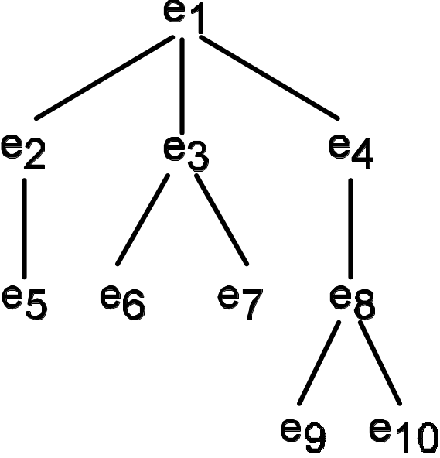
Tree Terminology
root: e₁
internal nodes: e₁, e₂, e₃, e₄, e₈
leaves: e₅, e₆, e₇, e₉, e₁₀
e₁ is the parent of e₂, e₃, e₄, so e₂, e₃, e₄ are siblings and are the children of e₁.
The degree of e₁ is 3. The degree of e₃ is 2 and the degree of e₉ is 0.
The arity of the tree is 3 – e₁ has 3 children and no other node in the tree has more children.
10-<number>

Slide 3
Tree Terminology
path e₁ – e₃ length: 2 depth e₁ depth: 1
examples: e₁ – e₄ – e₈ – e₁₀ length: 4 examples: e₂, e₃, e₄ depth: 2
e₅, e₆, e₇, e₈ depth: 3
e₉, e₁₀ depth: 4
height e₁ height: 4 width: 4
examples: e₃ height: 2 size: 10
e₁₀ height: 1
ancestors of e₁₀: e₈, e₄, e₁ descendants of e₄: e₈, e₉, e₁₀
recursive
definition
for ancestor
empty, if n is the root of the tree base case
n’s parent + ancestor(n’s parent), if n is not the root recursive case
ancestor(n) =
10-<number>

Slide 4
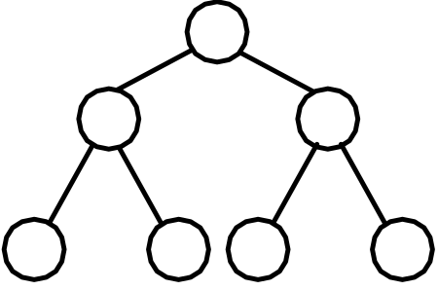
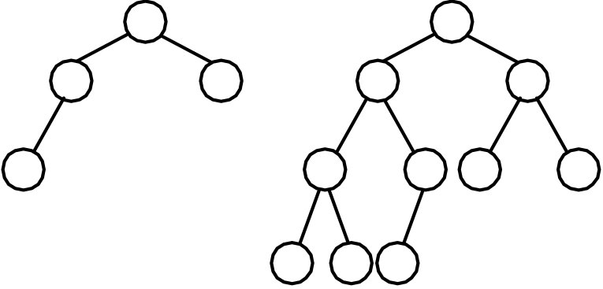
Binary Trees
A binary tree is a tree with an arity of 2 – a node may have 0, 1, or 2 children
(a) A full binary tree of height 3.
(b) Complete binary trees of height 3 and 4.
A full binary tree of height h is one in which all nodes from level 1 to level h – 1 have two children
A complete binary tree of height h is one in which all nodes from level 1 to h – 2 have two children and all the children of nodes at level h – 1 are contiguous and to the left of the tree
10-<number>

Slide 5

Binary Tree Properties
Property 10.1 A full binary tree of height h has 2^{h} – 1 nodes
Property 10.2 The height of a full binary tree with n nodes is
. Necessarily this is also the length of the longest path in a full binary tree
Property 10.3 The height of a binary tree with n nodes is at least and at most n (this occurs when no node has more than 1 child). This is also the length of the longest path
10-<number>

Slide 6
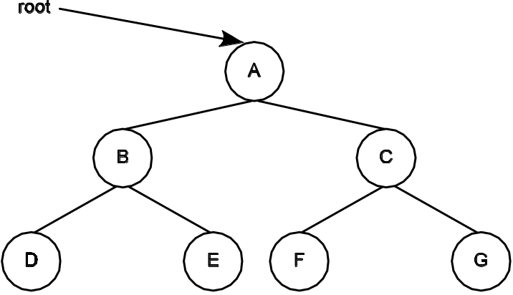
Tree Traversals
Traversal Order | Order in Which the Nodes Are Visited
preorder( node ) if node is not null visit this node preorder( node’s left child ) preorder( node’s right child ) | preorder(root) visits the nodes in the following order: A B D E C F G
inorder( node ) if node is not null inorder( node’s left child ) visit this node inorder( node’s right child ) | inorder(root) visits the nodes in the following order: D B E A F C G
postorder( node ) if node is not null postorder( node’s left child ) postorder( node’s right child ) visit this node | postorder(root) visits the nodes in the following order: D E B F G C A
levelorder( node ) if node is not null add node to a queue while the queue is not empty get the node at the head of the queue visit this node if the node has children put them in the queue in left to right order | levelorder(root) visits the nodes in the following order: A B C D E F G
Note the recursive nature
of preorder(), inorder()
and postorder()
10-<number>

Slide 7
Tree Traversals using an Iterator
This is how we did iterating for BasicCollection and the List implementations
With the iterator approach
  The collection provides the client with an iterator to walk through the elements of the collection
  The client controls the iteration via the iterator object
  The client applies some code to each element as it is “visited” (returned by the iterator)
10-<number>

Slide 8
Tree Traversals using an Iterator
A Binary Tree Object
A Client Object
TreeIterator iter =
tree.iterator(PREORDER);
while ( iter.hasNext() ) {
Object o = iter.next();
// do something clever with o
}
TreeIterator iterator(int
traversalOrder);
The tree supplies a separate mechanism (a TreeIterator object) for accessing the tree’s elements in some order.
The client controls the iteration via the TreeIterator object and decides what to do with each element returned by the iterator.
10-<number>

Slide 9
Tree Traversals with a Visitor
This is a simplified version of the software design pattern called, appropriately, Visitor.
With the visitor approach:
  The collection controls the traversal through some traversal method
  The client provides the tree with a visitor object that contains the code the client wants applied to the nodes of the tree
  The tree’s traversal method takes the visitor object and applies it to each node of the tree as the node is visited in the traversal
10-<number>

Slide 10
Tree Traversals with a Visitor
A Binary Tree Object
A Client Object
Visitor v = new SomeVisitor()
tree.preorderTraversal( v )
preorderTraversal( Visitor v ) {
v.visit( this Node )
preorderTraversal( this Node’s left child )
preorderTraversal( this Node’s right child )
}
The tree provides a traversal method that takes a Visitor as an argument. The method applies the Visitor to each node of the tree as the node is visited.
The client provides a block of code (the Visitor) that the tree applies to the nodes as they are visited during the traversal.
10-<number>

Slide 11
Binary Tree Specification
We need to be able to:
add a node at some position in the tree
remove a node and its descendants from a tree
traverse a tree
navigate around the tree by getting to a node’s parent and children
get an element from a node
10-<number>

Slide 12
Binary Tree Node
A binary tree node has four attributes:
the element to be stored in the node
the left child
the right child
the parent
10-<number>

Slide 13
Binary Tree Node
Because a client of a binary tree should only be able to alter a tree through tree operations, BinaryTreeNode provides a mutator for only the element attribute
Access to a binary tree node’s other attributes must be done under the control of the tree to which the node belongs
How this is done is up to the implementation
  An implementation can decide to provide accessors and mutators, or could choose to implement the attributes as protected fields, accessible directly by name
10-<number>

Slide 14
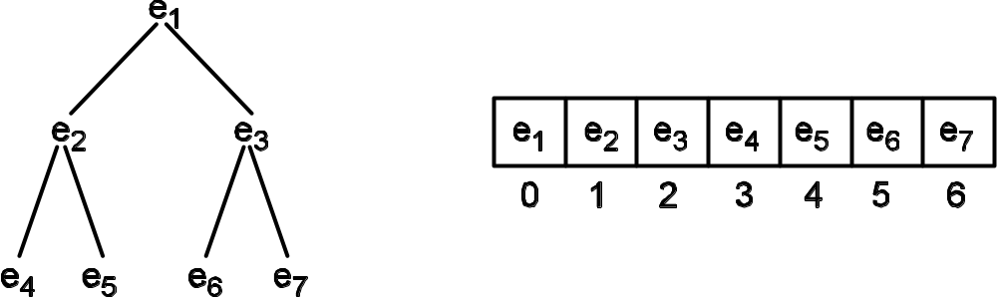
Array Implementation of Binary Tree
What makes this possible is that a binary tree has a regular structure – every node can have zero to two children, which allows us to define a mapping of the nodes of a full binary tree of height h to an array of length 2^{h} – 1.
10-<number>

Slide 15



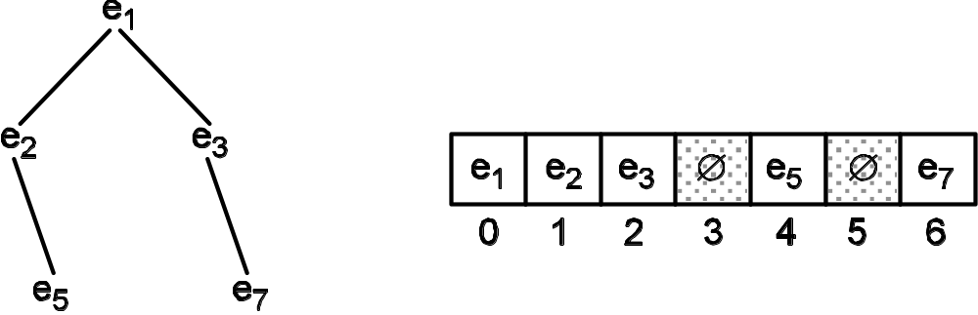
Array Implementation of Binary Tree
Navigating around the tree when it is laid out in an array:
For a node in position i, its
• left child is in position 2 × i + 1
• right child is in position 2 × i + 2
• parent is in position
For a full tree with n nodes, the interior nodes of the tree are all found in positions 0 to
, and the leaves are
found in positions
to n – 1
Need a way to indicate
an empty child
10-<number>

Slide 16
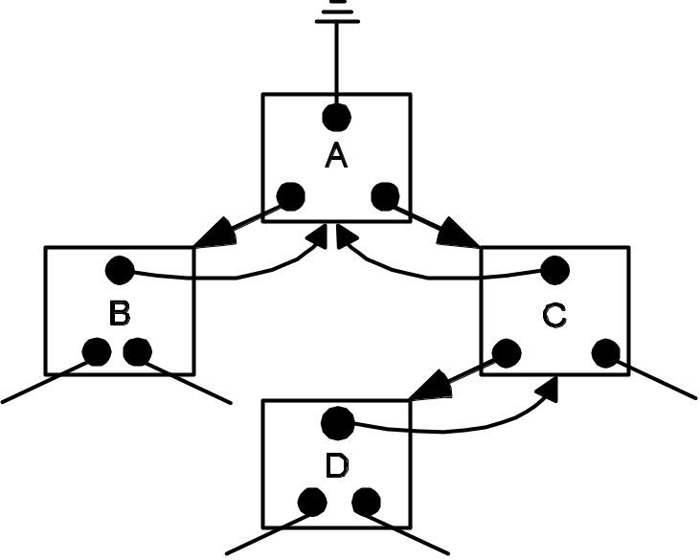
Linked Binary Tree
public class LinkedBinaryTreeNode<E>
implements BinaryTreeNode<E> {
protected E element
protected LinkedBinaryTreeNode<E> parent;
protected LinkedBinaryTreeNode<E> leftChild;
protected LinkedBinaryTreeNode<E> rightChild;
Data fields are protected, allowing
direct access by other classes in the
same package
Having parent and child references
makes it easier to move up and down
the tree – this is a hierarchical doubly
linked list (sort of)
10-<number>

Slide 17
Tasks to complete to implement LinkedBinaryTree
1. Implement a constructor that creates a tree from an element and two subtrees
2. Implement remove() to remove a node from the binary tree
3. Implement preorderTraversal() using a Visitor
We’ll focus on 2 and 3 here
10-<number>

Slide 18
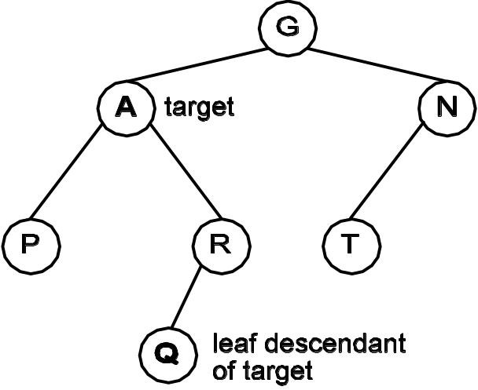
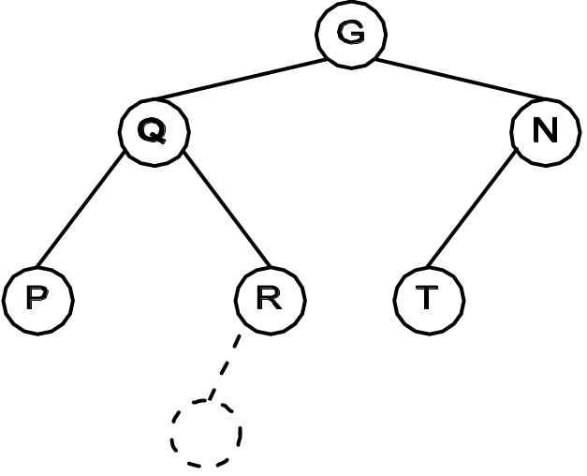
Binary Tree: Remove()
Removing a leaf node is simple (not shown)
Removing an interior node is a bit trickier (see below)
(a) Target node A is an internal node; find a leaf in one of its subtrees
(b) Replace target’s element with the element from a leaf descendant; remove the leaf
10-<number>

Slide 19
Binary Tree: Remove()
1 public void remove( BinaryTreeNode<E> target ) {
if target is null there is nothing to do, so return
2 if ( target == null )
3 return; // nothing to remove
4 LinkedBinaryTreeNode<E> node = (LinkedBinaryTreeNode<E>) target;
if target is internal
5 // If this is an internal node, we need to get another
6 // node (a leaf descendant) to put in its place
7 if ( node.isInternal () ) {
get a leaf descendant of target; move leaf ’s element into target
and detach the leaf
8 LinkedBinaryTreeNode<E> leaf = getaLeafDescendant( node )
9 node.setElement( leaf.element() );
10 }
else target is a leaf and needs to be detached
11 else
12 detachFromParent( node );
decrement tree’s size by 1
13 size--;
14 }
10-<number>

Slide 20
The Visitor Interface
1 package gray.adts.binarytree;
2
3 /**
4 * Implementation of the Visitor design pattern.
5 */
6 public interface Visitor<E> {
7
8 /**
9 * Visit the specified node.
10 * The implementation determines what, if anything,
11 * will be done with the node.
12 * @param node The node to visit.
13 */
14 public void visit( BinaryTreeNode<E> node );
15 }
10-<number>

Slide 21
The Binary Tree preOrderTraversal() method
This is the method the public sees.
1 void preOrderTraversal( Visitor<E> visitor ) {
2 doPreOrderTraversal( this.root(), visitor );
3 }
preorder( node, visitor )
4 void doPreOrderTraversal(BinaryTreeNode<E> node, Visitor<E> visitor){
if the node is null return
5 if ( node == null ) // base case
6 return;
7 // node is not null - recursive case
8 LinkedBinaryTreeNode<E> thenode = (LinkedBinaryTreeNode<E>) node;
visit this node
9 visitor.visit( thenode );
preorder( node’s left child)
10 doPreOrderTraversal( thenode.leftChild (), visitor );
preorder( node’s right child)
11 doPreOrderTraversal( thenode.rightChild(), visitor );
12 }
This is the method that does the work.
10-<number>

Slide 22
The ToListVisitor Class
1 package gray.adts.binarytree;
2
3 import java.util.List;
4 import java.util.ArrayList;
5
6 /**
7 * A Visitor class for converting a tree into a <tt>List</tt>.
8 * The order in which the elements of the tree are placed in the
9 * list is determined by the tree traversal used. This class
10 * implements the Visitor design pattern.
11 */
12 public class ToListVisitor<E> implements Visitor<E> {
13 private List<E> list;
14
15 /**
16 * Create an empty list into which <tt>visit</tt> will
17 * append the tree's elements.
18 */
19 public ToListVisitor(){
20 list = new ArrayList<E>();
21 }
22
23 /**
24 * Return the list of elements.
25 * @return A list of the elements from a tree.
26 */
27 public List<E> list(){
28 return this.list;
29 }
30
31 /**
32 * Appends the specified node to the end of the list.
33 */
34 public void visit( BinaryTreeNode<E> node ){
35 list.add( node.element() );
36 }
37 }
To get the list of tree elements
Specified by the Visitor interface
10-<number>

Slide 23
Using ToListVisitor
1 import gray.adts.binarytree.*;
2 import java.util.List;
3 import java.util.Iterator;
4
5 /**
6 * Example usage of the ListVisitor.
7 */
8 public class ToListVisitorEx {
9
10 public static void main(String[] args) {
11 BinaryTree<String> tree = new LinkedBinaryTree( "A" );
. . . code to populate the tree goes here . . .
22 System.out.println("preorder traversal: ");
23 ToListVisitor<String> listMaker =
24 new ToListVisitor<String>();
25 tree.preOrderTraversal( listMaker );
26 List<String> list = listMaker.list();
27
28 for( String s : list )
29 System.out.print( "\t" + s + " " );
System.out.println();
. . . code for other traversal orders goes here . . .
1. create a visitor
to collect the tree’s elements in a list
2. ask the tree to do
a preorder traversal
applying the visitor
to each node
3. get the result of
the traversal
10-<number>

Slide 24
Output of the Traversal
Four traversals are done.
Each traversal takes a
ToListVisitor object to
collect the tree’s elements
as they are encountered
during the traversal.
OUTPUT
preorder traversal:
A B D E C F G
inorder traversal:
D B E A F C G
postorder traversal:
D E B F G C A
levelorder traversal:
A B C D E F G
10-<number>

Slide 25
Testing the Implementation
As before, construct instances of the collection and verify behavior
Challenge for a tree is ensuring that elements are in the correct position within the tree following and add or delete
Solution: dump the tree’s elements to a list and compare the order of the list’s elements against what is expected ⇒ use ToListVisitor!
10-<number>

Slide 26
Test Case Example for Merging Trees
The test fixtures tree2 and tree3 were built in setUp() for us
26 public void testMergeTrees(){
27 BinaryTree<Integer> mergedTree =
28 new LinkedBinaryTree<Integer>(tree2, 0, tree3);
29 assertEquals( mergedTree.size(), 9 );
30
31 List<Integer> expectedTreeList = new ArrayList<Integer>();
32 expectedTreeList.add( 0 );
33 expectedTreeList.add( 2 );
34 expectedTreeList.add( 2 );
35 expectedTreeList.add( 1 );
36 expectedTreeList.add( 4 );
37 expectedTreeList.add( 5 );
38 expectedTreeList.add( 3 );
39 expectedTreeList.add( 6 );
40 expectedTreeList.add( 7 );
41
42 ToListVisitor<Integer> treeVisitor = new ToListVisitor<Integer>();
43 mergedTree.preOrderTraversal( treeVisitor );
44 assertTrue( treeVisitor.list().equals( expectedTreeList ) );
45 }
Build the list we expect to
receive from ToListVisitor
Use ToListVisitor to get the
merged tree’s elements
10-<number>
See if the two lists are equal

Slide 27
Evaluation of the Implementation
The cost of traveling from the root
  Best case is a complete binary tree: O(log₂n)
  Worst case is when the tree is very unbalanced: O(n)
The add and remove operations involve a few link updates, so are O(1)
  If you include the time to find the insertion or deletion point, they are O(n), in the worst case
Array implementation: address computation for each “link”
Linked implementation: memory lookups for each link
10-<number>

Slide 28
Heaps and Binary Trees
A heap is a special kind of binary tree that has the
following properties
Property 10.4 The heap’s binary tree is a complete binary tree
Property 10.5 A heap is either a minheap or a maxheap, which can be defined recursively as follows:
minheap – The element in a node is less than or equal to the elements in its children. Each child is the root of a minheap
maxheap – The element in a node is greater than or equal to the elements in its children. Each child is the root of a maxheap
10-<number>

Slide 29
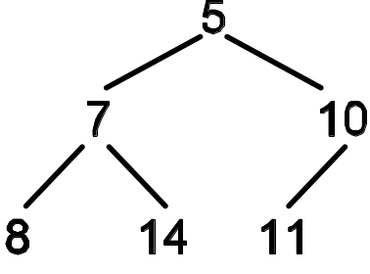
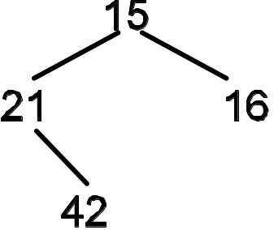
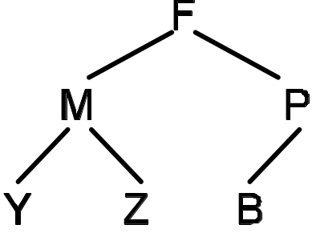
Valid and Invalid Minheaps
(a) A valid minheap.
(b) An invalid minheap (violates the complete binary tree property: 21’s left child is missing).
(c) An invalid minheap (violates the minheap property: P is greater than B).
10-<number>

Slide 30
The Heap ADT
Description
A heap stores a collection of comparable elements and allows the smallest (minheap) or largest (maxheap) element to be read and removed from the collection.
Attributes
comparator: The Comparator to use to compare elements of the heap.
size: The number of elements in the heap.
top: The top element of the heap—the root of a complete binary tree.
Properties
1. A heap is always a complete binary tree.
2. If this is a minheap, the value in each node is less than or equal to the values of its children.
3. If this is a maxheap, the value in each node is greater than or equal to the values of its children.
10-<number>

Slide 31
The Heap ADT
Operations
heap ( Comparator compare )
pre-condition: compare is not null
responsibilities: constructor—create an empty heap. The ordering
of elements in the heap will be defined by the
Comparator compare
post-condition: size is 0
top is null
comparator is set to compare
returns: nothing
exception: if compare is null
Other operations
add( Type element ) insert element into the heap, maintaining the heap properties
. . .
Type top() remove & return the top element
. . .
Type peek() return the top element
10-<number>

Slide 32
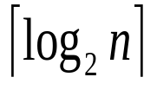
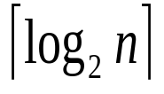
Adding an Element to a MinHeap
Pseudocode: add( element)
1. insert the new element as the new rightmost leaf on the bottom level
2. increment size by 1
3. while the new element has a parent and the new element is less than its parent
4. swap the parent and child elements
The cost of the add() operation is bounded by the distance the new element can travel.
Since the new element starts as a leaf and the highest it can climb is to the root, this bound is the height of the tree. By Property 10.2, we know this to be , so the cost of add() is O( )
10-<number>

Slide 33
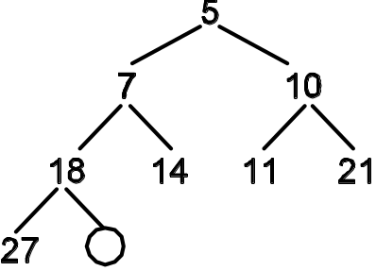
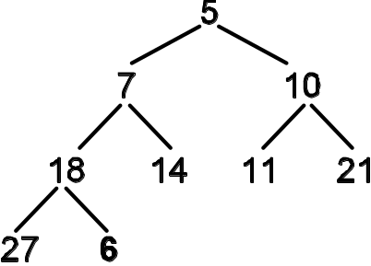
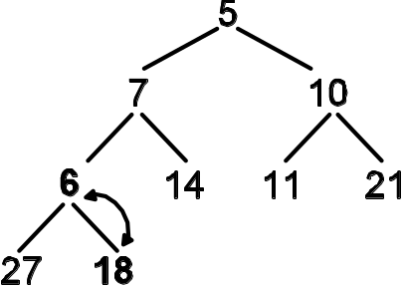
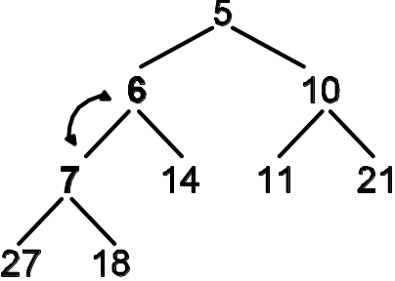
Adding an Element to a MinHeap
(a) A minheap prior to adding an element. The circle is where the new element will be put initially.
(b) Add the element, 6, as the new rightmost leaf. This maintains a complete binary tree, but may violate the minheap property.
(c) Starting with the new element, if the child is less than the parent, swap them. This moves the new element up the tree.
(d) Repeat the step described in (c) until the parent of the new element is less than or equal to the new element. The minheap property has been restored.
10-<number>

Slide 34
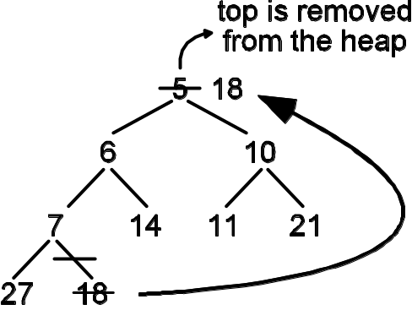
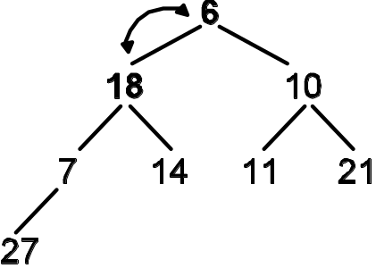
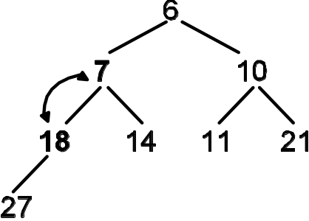
Removing an Element from a MinHeap
(a) Moving the rightmost leaf to the top of the heap to fill the gap created when the top element (5) was removed. This is a complete binary tree, but the minheap property has been violated.
(b) Swapping top with the smaller of its two children leaves top’s right subtree a valid heap. The subtree rooted at 18 still needs fixing.
(c) Last swap. The heap is fixed when 18 is less than or equal to both of its children.
10-<number>

Slide 35
Removing an Element from a MinHeap
Pseudocode: top() // remove and return the top element of the heap
1. extract the top element from the heap and store it in oldTop
2. move the rightmost leaf into top
3. decrement size by 1
4. fixHeap( top ) // fix the heap starting at the top
5. return oldTop
Pseudocode: fixHeap( node ) // fix the heap rooted at node
1. let cursor reference node
2. while the cursor has a child and the cursor’s element is greater than the element
in either child
3. // invariant: the cursor’s children are roots of valid heaps
4. swap the cursor’s element with the element of the smaller of cursor’s children
5. // invariant: the cursor and its children are a now valid heap
6. move cursor to the swapped child
7. // loop post-condition: the binary tree rooted at node is a valid heap
As with add(), the cost is bounded by the height of the tree: O( )
10-<number>

Slide 36
Building a Heap from a Collection
Assume the collection is stored in an array
We know we can represent a binary tree in an array easily
Treat the array as an improperly formed heap and fix it
Secret: Since the leaves must already be heaps, we can start the fixing process with the first internal node
10-<number>

Slide 37
Building a Heap from a Collection
Pseudocode: buildHeap( Collection c )
move the elements of c into a complete binary tree rooted at top
let cursor be the rightmost interior node
// invariant: the children of cursor are valid heaps
while there are heaps to fix
fix the heap rooted at cursor
move cursor to the next rightmost unvisited interior node
10-<number>

Slide 38

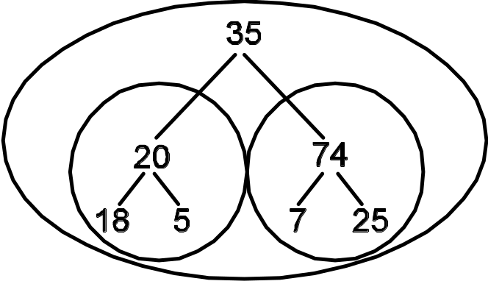
Building a Heap from a Collection
(a) A collection of random elements.
(b) The collection mapped to a Binary Tree. The circled subtrees are heaps that must be fixed. The leaves are also heaps, but a heap of size 1 is always valid.
10-<number>

Slide 39
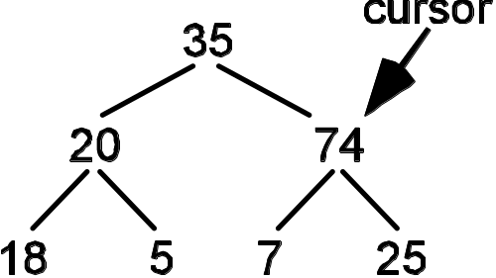
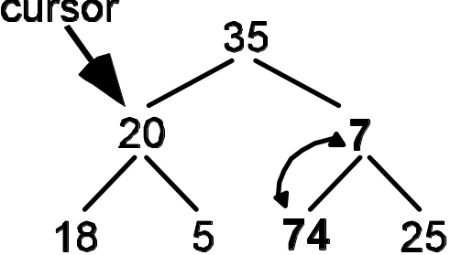
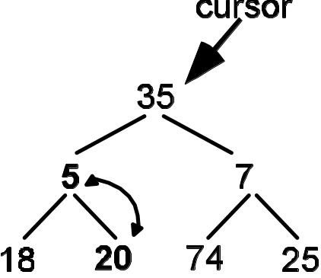
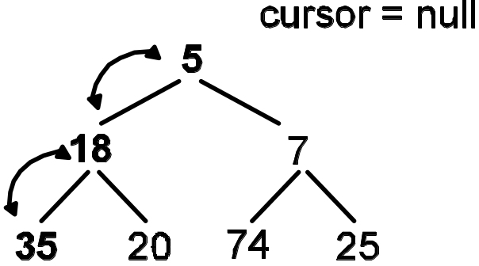
Building a Heap from a Collection
(a) Start with cursor at the rightmost interior node. Invariant: cursor’s children are always valid heaps.
(b) When the heap is fixed by swapping the parent’s value with the smaller of its children, move cursor to the next node to the left on the current level.
(c) When all the nodes on a level have been visited, move cursor up a level, starting at the right side, moving left. Note that cursor’s children are the roots of valid minheaps.
(d) Fixing the heap starting at the top required two swaps. After this, cursor is null, indicating there are no more heaps left to fix.
10-<number>

Slide 40
Heap Sort!
heapSort( Collection c )
1 <T> List<T> heapSort( Collection<? extends T> collection,
2 Comparator<? super T> comparator ){
if the collection is empty or null
3 if ( collection == null || comparator == null )
return null
4 return null;
create a heap from a collection
5 Heap<T> heap = new ArrayMinHeap<T>( collection, comparator );
create an empty list
6 List<T> list = new ArrayList<T>();
while the heap is not empty
7 while ( !heap.isEmpty() ) {
get the top element from the heap
8 T e = heap.top();
append it to the list
9 list.add( e );
10 }
11 return list;
12 }
Time complexity of heapsort():
O(nlog₂n) for buildHeap on line 5
The while loop executes n times and the cost of top() on line 8 is log₂n, making the total cost O(nlog₂n)
Space complexity: O(n) for the list - can be O(1)
10-<number>

Slide 41

Implementing a Heap Using an Array
An array is a good data structure for storing the elements of a binary tree because it provides fast access to a node’s parent and children. It also makes finding the rightmost interior node and the rightmost leaf easier:
• The rightmost leaf is always in position size – 1 of the array
• The rightmost interior node is always in position of the array, for size > 1.
Doing a “reverse” level order traversal, which is needed for buildHeap(), is as easy as walking backward through the array from down to 0.
10-<number>

